Slide 1
The Power of Togetherness
Making a Case for Partnerships, Collaborations, and Community Impact
Steve Nowak
Executive Director
Douglas County Historical Society
September 18, 2023

Slide 2
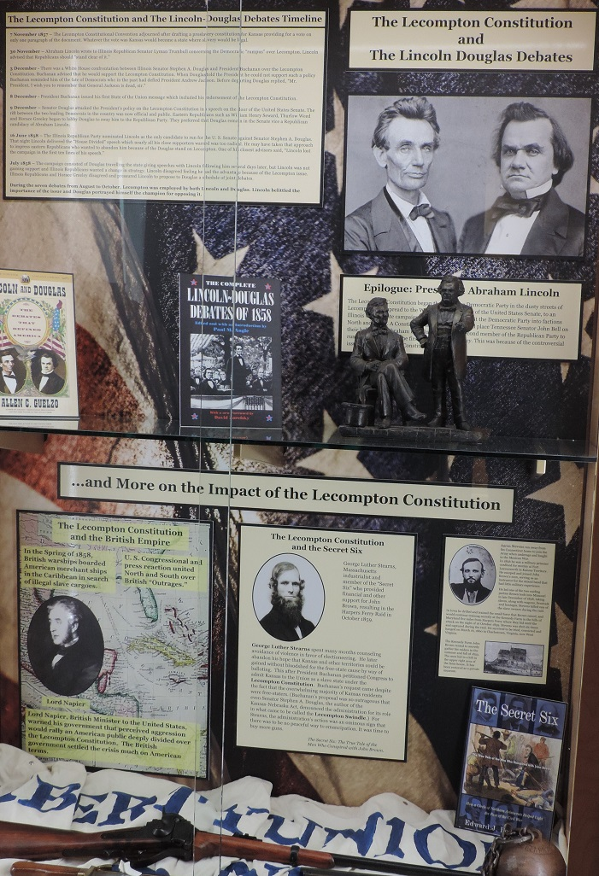
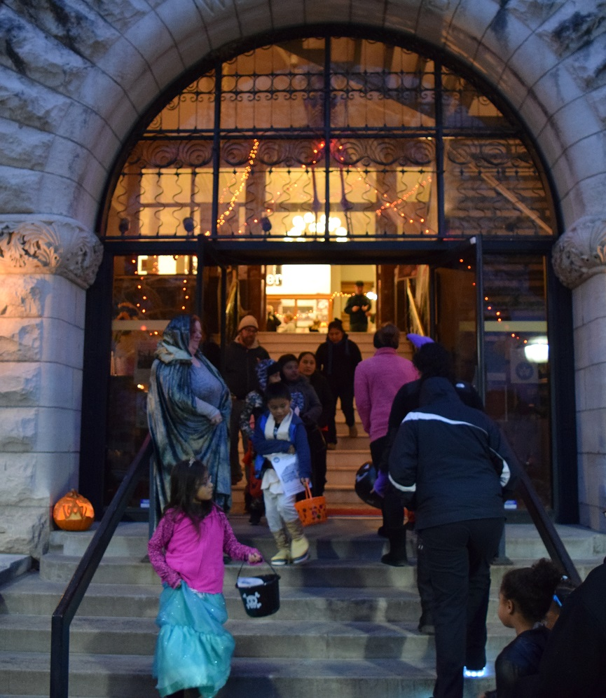
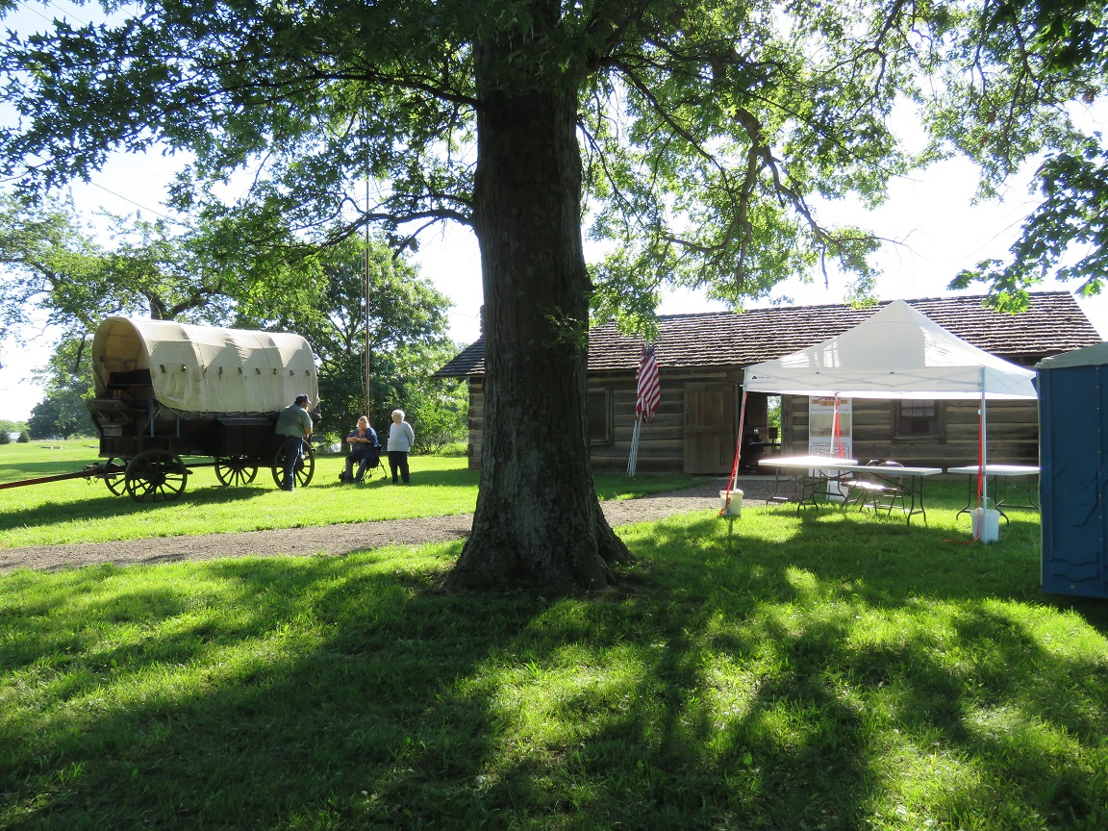
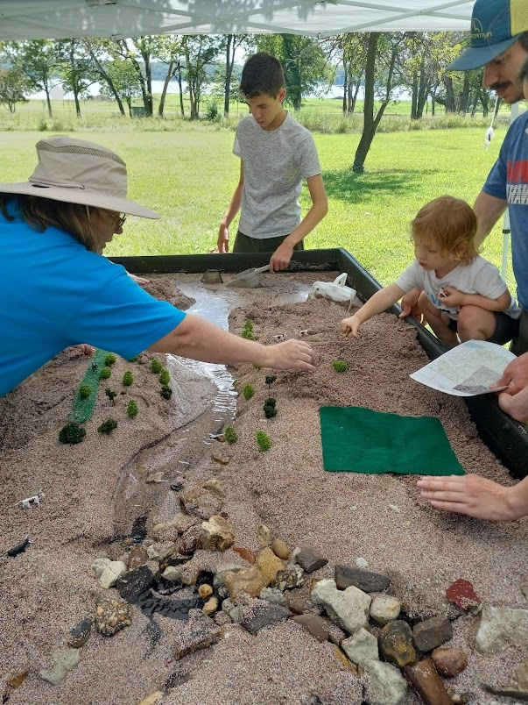
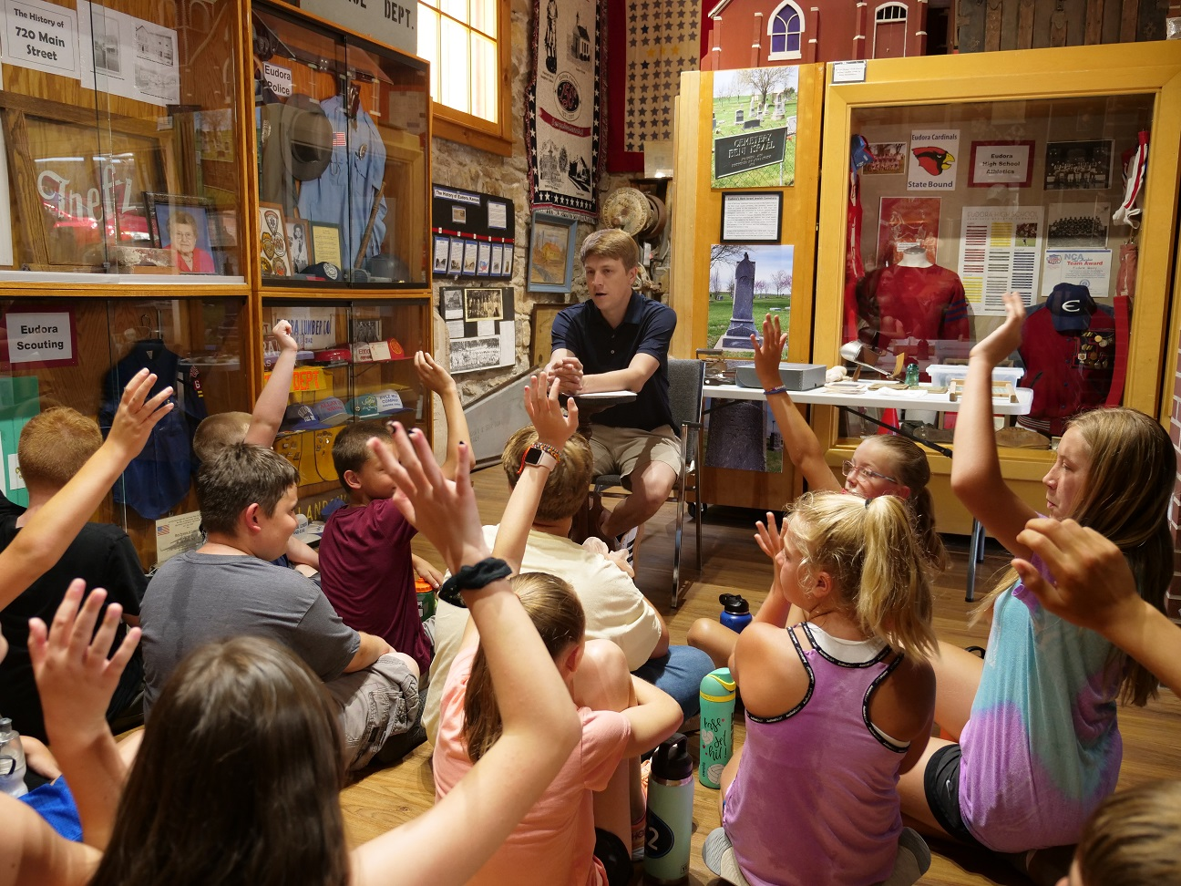
The Douglas County, Kansas Heritage Partners
Territorial Capital Museum
Watkins Museum of History
1975: Douglas County Historical Society
1977: Clinton Lake Historical Society
1980: Lecompton Historical Society
2002: Santa Fe Trail Historical Society
2012: Eudora Area Historical Society
2017: Black Jack Battlefield Trust
Ivan Boyd Memorial Prairie
Black Jack Battlefield and Nature Park
Eudora Community Museum
Wakarusa River Valley Heritage Museum

Slide 3
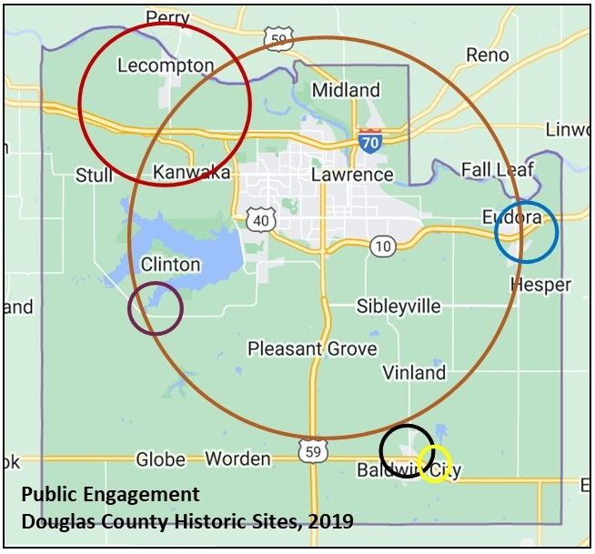
Community Impact
Preserve historically significant structures, properties, artifacts, and archives
Share cultural heritage stories with residents and visitors
Assure public access to the county’s historical resources
Engage visitors of all economic and educational backgrounds, and demographic makeup
Maintain partnerships within and outside Douglas County

Slide 4
Economic Impact
Leverage County Funds
Activate Volunteers 11,000 annually Provides labor valued at $331,337
Engage Residents Annual attendance at historic sites is the equivalent of 31% of the county’s population
Impact Local Economy Collective annual budget of about $800,000 and annual visitation of over $36,000 generates economic impact of $3,197,645

Slide 5
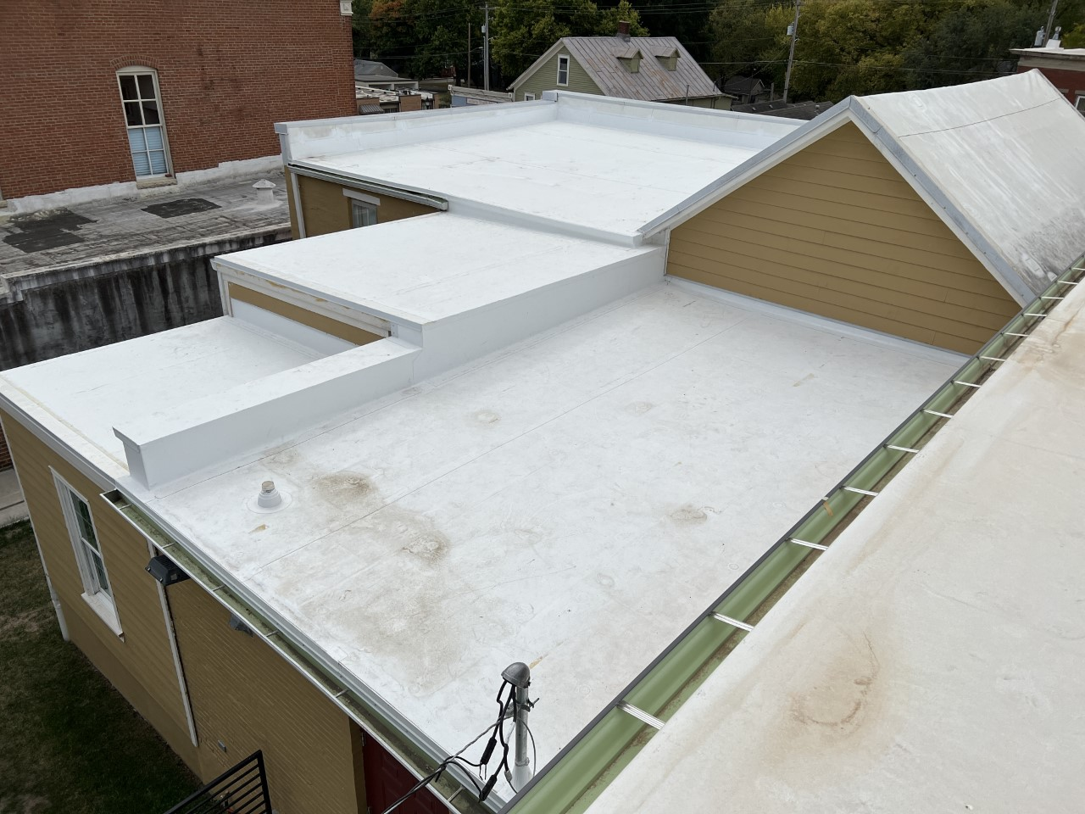
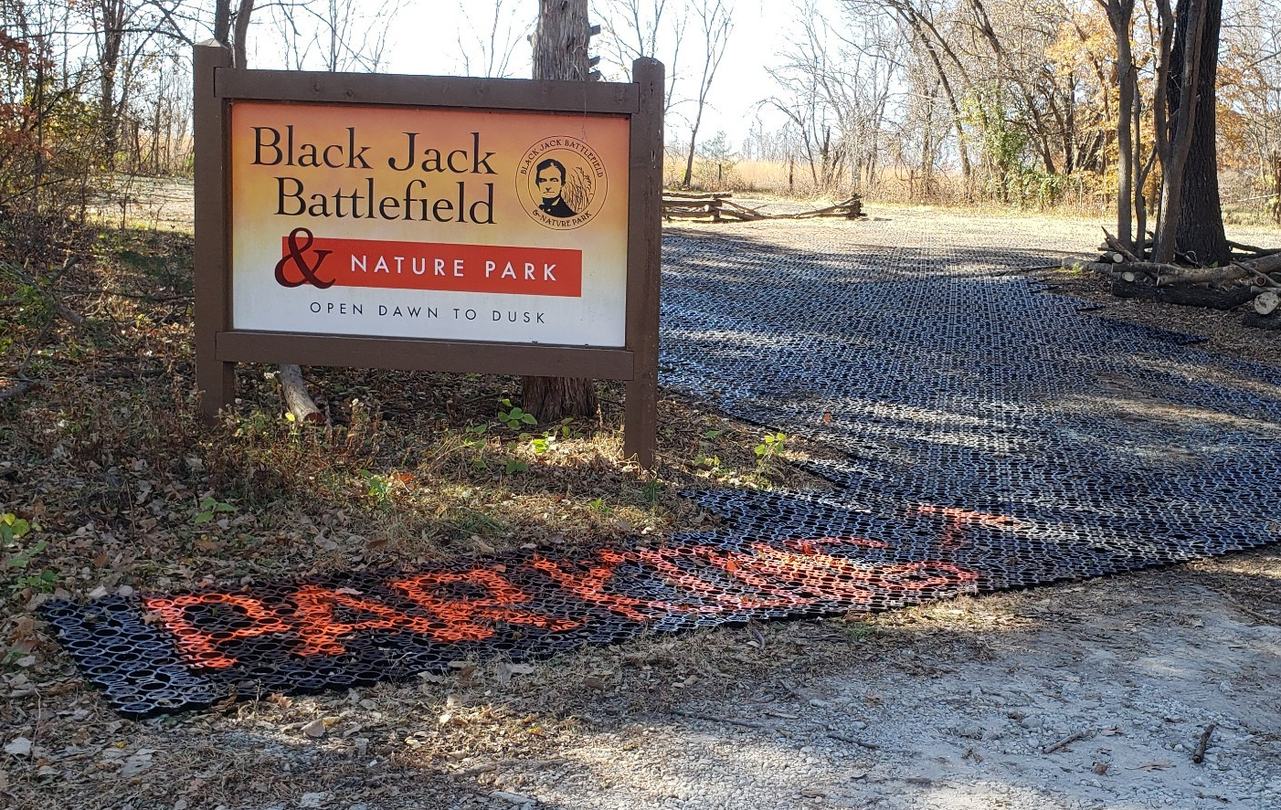
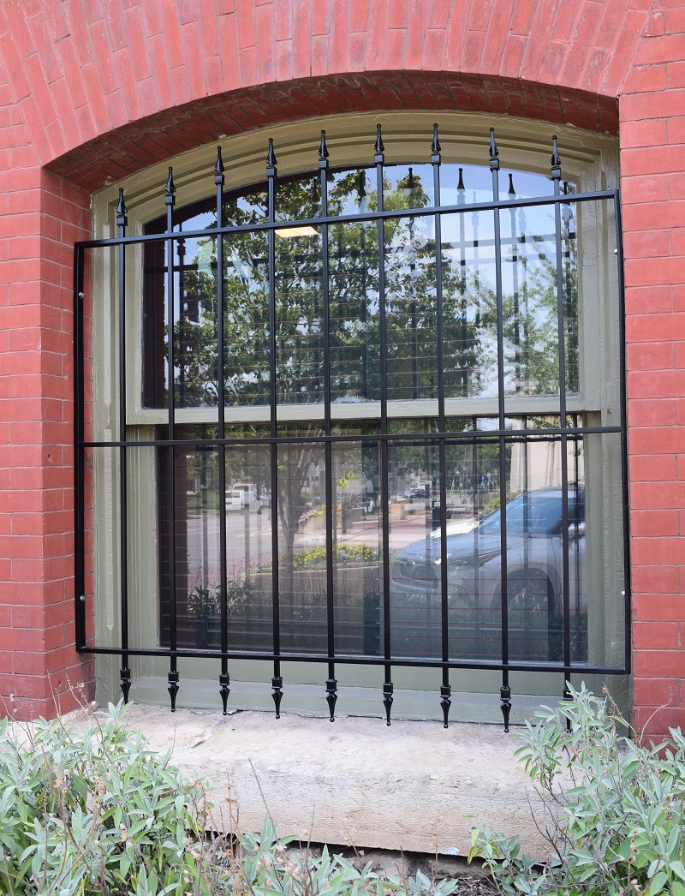
Leveraging Collective Impact
New Roof
Grants NEH: $49,795 IMLS: $49,980 CARES Act (through City of Lawrence): $149,958 ARPA (Through Douglas County): $732,539
Shared Resources Field Trip Curriculum Summer Family Program Research Assistant
Additional Funding Douglas County Supplemental Funding 2024
Parking Lot
Window Restoration

Slide 6
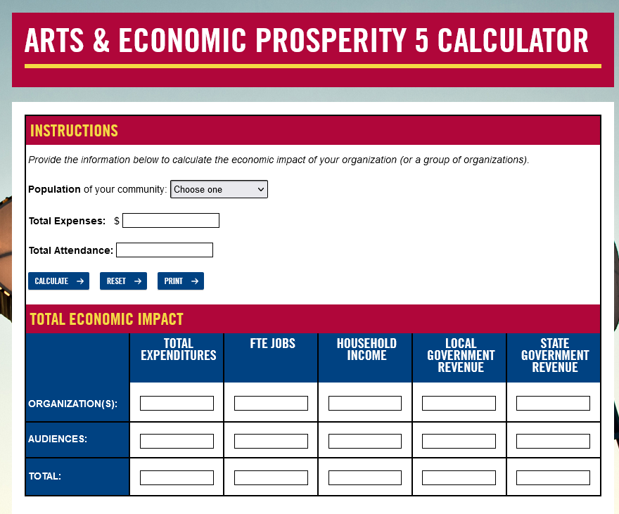
How to Get Started
Strengths
Historic structures and collections
County-wide communication network
Large volunteer base
Experience with public engagement
Weaknesses
Reduced on-site attendance due to pandemic
Reliance on grants for operational support
One-year planning cycle
Opportunities
Shared resources, expertise, and staff
Artifact-based learning in Kansas curriculum
Heritage programming can engage underrepresented communities
Threats
Increasing operational expenses due to inflation
Aging physical and technological infrastructure
Aging volunteer base
Get to know each other
Collect statistics
Use the calculators
Speak their language
https://www.americansforthearts.org/

Slide 7
Discussion? Questions?

