Slide 1

What is a National Heritage Area?
  A﻿ National Heritage Area is a designated place (by Congress) with a combination of unique natural, cultural, historic, and recreational elements of significance to our shared American heritage.
    A National Heritage Area employs a partnership approach to heritage development involving collaborative planning around a theme, industry and/or geographical feature that influenced the nation’s culture and history.
  Freedom's Frontier is commissioned to promote 3 themes:
    Settling the Western Frontier
    The "Border War" in the larger Civil War context
    The Enduring Struggle for Freedom
  There are 62 designated and active National Heritage Areas in 36 states
Notes:
I’m Kate Sutter and until the Dec, I spent 16.5 years teaching mostly American History in southwest Missouri. I have changed roles a bit now, but I am still promoting history – just with a new audience. I’m now with Freedom’s Frontier National Heritage Area. There are 62 NHAs that have been created since 1984, and changing or adding to them literally takes an act of Congress – but it is possible because at the beginning of this calendar year we were reauthorized for 15 more years! We are not part of the National Park Service but receive most of our funding from them to distribute to the partners to promote tourism and the local economy. Each NHA has themes to focus on and as you can see, ours are listed in blue.

Slide 2
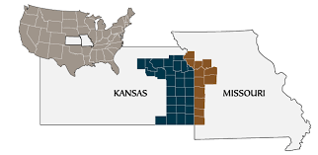
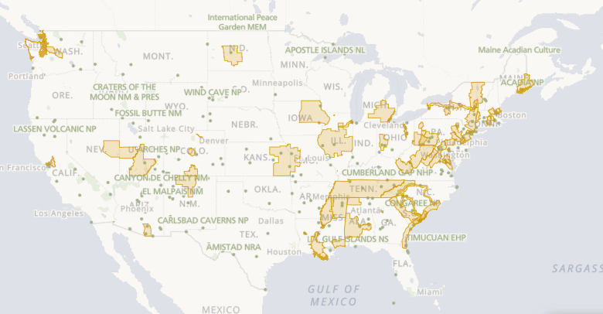
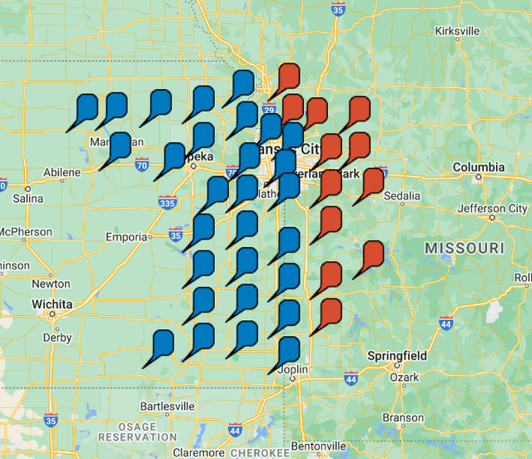
Where are the 62 NHAs?
(Hint: Probably near you!)
Images are hyperlinks - please click
Notes:
If you open this presentation, each of the maps here are hyperlinked to a webpage. The large US map shows the boundaries of the current NHAs and the site lists what is found in each state. The MO/KS map is the heritage area known as Freedom’s Frontier, and we cover 41 counties. The counties are designated in the lower right with blue and red flags. It’s a screen shot from our app, which you can download in your app store or using the QR code. Within these counties, sites or organizations that pertain to at least one of our 3 themes can partner with us (for free) and access our resources – like grants and programming. Currently Freedom’s Frontier have well over 200 partners.

Slide 3
How can they help communities?
From ANHA:
An independent 2012 study found that NHAs’ overall annual economic impact in the U.S. is $12.9 billion, exceeding the amount of federal funding provided by as much as 5:1. The majority of impact (99%) is generated by tourism spending.
      $4.6 billion in direct impact, which includes tourist spending, NHA operational expenditures and grantmaking activities.
      $8.3 billion in indirect and induced impacts, which includes employee spending and businesses supporting the tourism industry.
      $700,000 (in 2021) of funds from FFNHA went towards programming
“National Heritage Areas are places where small investments pay huge dividends, providing demonstrable benefits in communities across the country and in partnership with our National Parks.” —Jon Jarvis
Notes:
As you can see, teachers and student groups can benefit as well! In 2020, which we know had limited educational opportunities, NHAs still supported almost 5000 programs with over $1 million. Most of this funding was used at historic sites and encouraging people to visit them. As you can see, we like history. And students. And helping teachers

Slide 4


Field Trip Options
  Bring Students to your Sites!
    The Bus on Us component of our Education Grants can provide up to $250 toward the transportation of K-12 students who are visiting our partners to support the learning of our themes!
Scan here for a large yet
partial list!
Notes:
If you are a teacher within our counties, or close enough to visit one of our partners, we may be able to help you! We have education grants that we are currently revamping for next school year. One of our most popular programs encourages place-based learning through field trips to our partner sites, up to $250. While we’re still finetuning those things, we can also entertain requests for obtaining curricular materials aligned with our themes. We want to help you guys as easily as we can make it for you.

Slide 5
How can partnering with FFNHA help sites?
Collective Wisdom and Collaboration
  “Freedom’s Frontier made it possible for me to do my job!” – Steve Nowak
Professional Development
Marketing Opportunities
Technical and Programming Assistance
Potential for Project Grants: Opportunities for up to (typically) $3000 toward individual projects
  They must interpret or help communicate the themes of Freedom’s Frontier: Settling the Western Frontier, the Border War theatre of the Civil War, and/or the Enduring Struggle for Freedom.
Notes:
As you can see, teachers and student groups can benefit as well! In 2020, which we know had limited educational opportunities, NHAs still supported almost 5000 programs with over $1 million. Most of this funding was used at historic sites and encouraging people to visit them. As you can see, we like history. And students. And helping teachers

Slide 6

Reach out
  Network and trouble-shoot with other partners you’ve met!
  Contact Freedom’s Frontier National Heritage Area to see what assistance we can provide you!
  Tell your local schools about visiting your site!
  Help us help you!

